Slide 1
Современный Computer Vision. Какой он в разработке и исследованиях?
Vladyslav Kolbasin
Senior Data Scientist at INSART
Consultant at Globallogic
Lecturer at CMAD dep. at NTU “KhPI”

Slide 2
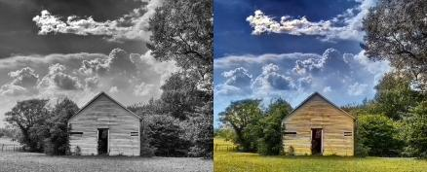
Image Processing
Classification
Object Detection
Semantic Segmentation
Instance Segmentation
Summarization
Captioning
Colorization
Notes:
https://www.learnopencv.com/convolutional-neural-network-based-image-colorization-using-opencv/

Slide 3
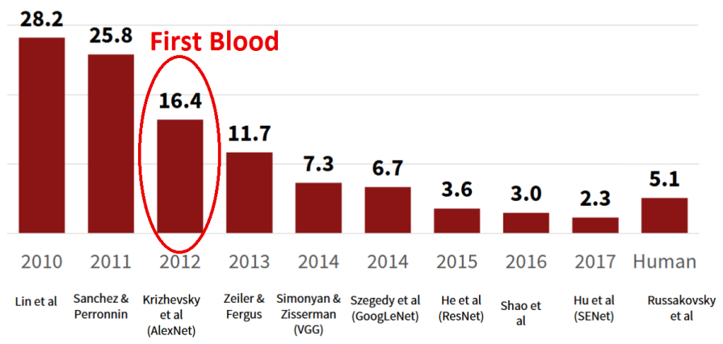
ImageNet classification error through years

Slide 4
Lesion classification & segmentation
Competition Skin Lesion Analysis Towards Melanoma Detection
Segment image - find lesion in the picture
https://challenge.kitware.com/#challenge/560d7856cad3a57cfde481ba

Slide 5
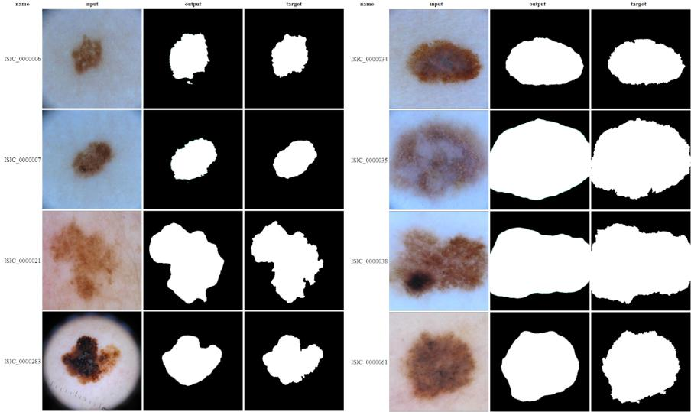

Slide 6
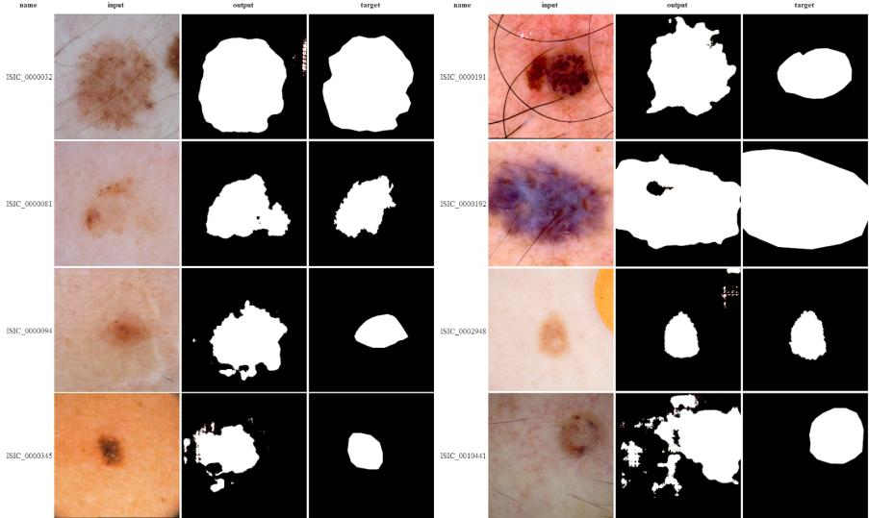

Slide 7
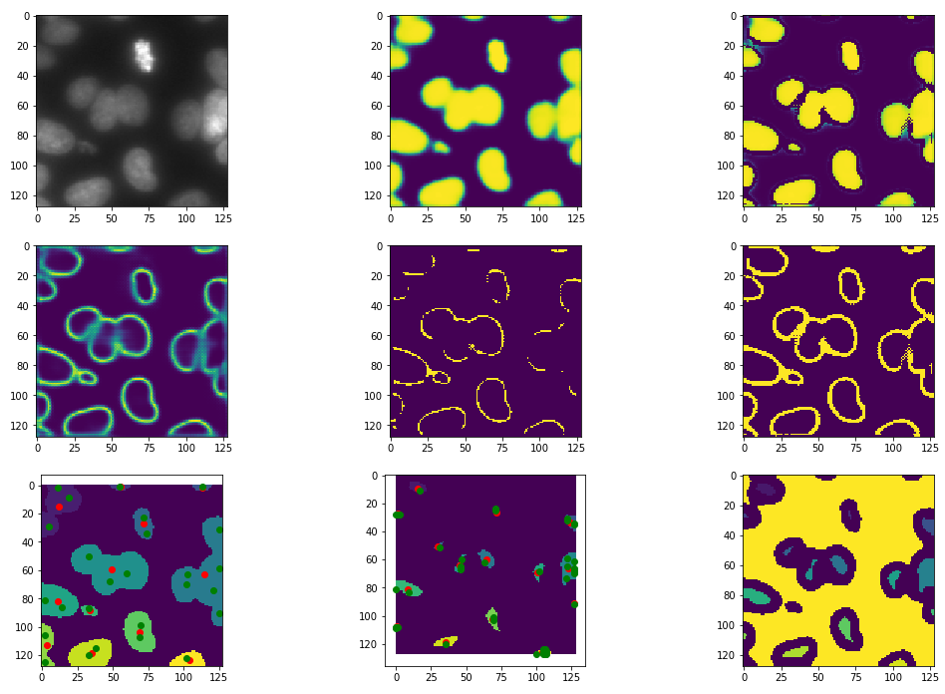

Slide 8
DS Bowl 2018

Slide 9
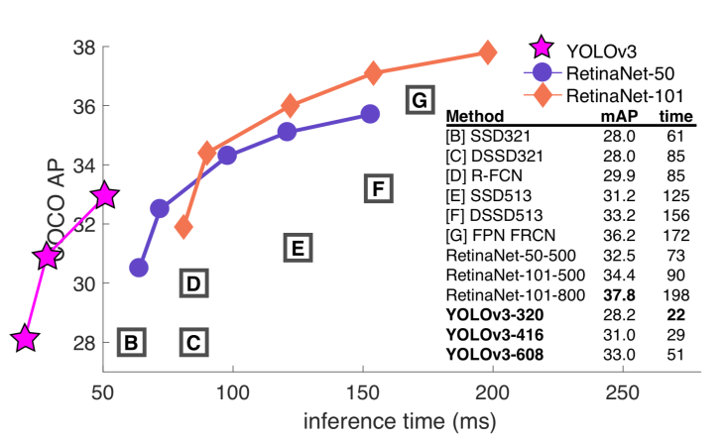
Algorithms comparison

Slide 10
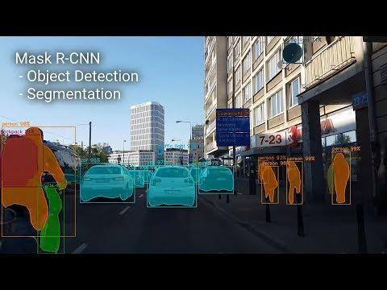
Mask-R-CNN. Demo
https://www.youtube.com/watch?v=OOT3UIXZztE
Notes:
https://www.youtube.com/watch?v=OOT3UIXZztE - Demo on COCO dataset
https://www.youtube.com/watch?v=OOT3UIXZztE&feature=youtu.be&t=754 - Странности 4K Mask RCNN COCO

Slide 11
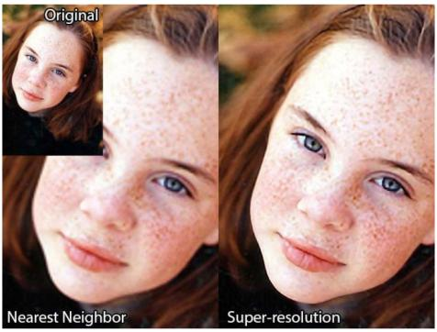
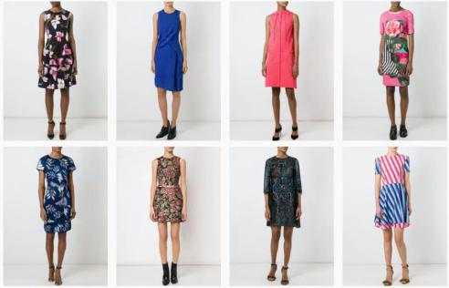
Realistic generation tasks
Notes:
https://www.cs.toronto.edu/~duvenaud/courses/csc2541/slides/gan-applications.pdf
https://qz.com/1090267/artificial-intelligence-can-now-show-you-how-those-pants-will-fit/
Only two of these images were taken by a camera. (Spolier: Row 1, C and Row 2, D)

Slide 14
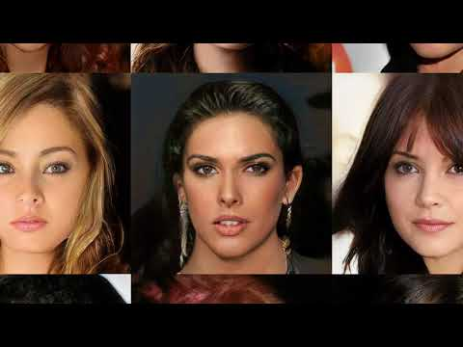
Realistic generation tasks
https://github.com/tkarras/progressive_growing_of_gans https://arxiv.org/abs/1710.10196
Notes:
https://youtu.be/XOxxPcy5Gr4?t=1m20s

Slide 15
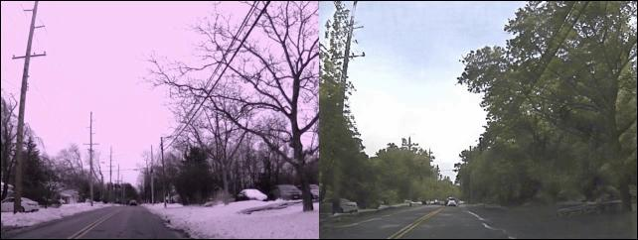
Unsupervised Image-to-Image Translation

Slide 16
FSGAN: Subject Agnostic Face Swapping and Reenactment (2019)
https://nirkin.com/fsgan/

Slide 17
DeepFakes - Huge Problem
Fraudsters Used AI to Mimic CEO’s Voice in Unusual Cybercrime Case https://www.wsj.com/articles/fraudsters-use-ai-to-mimic-ceos-voice-in-unusual-cybercrime-case-11567157402
Creating a data set and a challenge for deepfakes https://ai.facebook.com/blog/deepfake-detection-challenge
Deepfake Detection Challenge https://deepfakedetectionchallenge.ai/

Slide 18
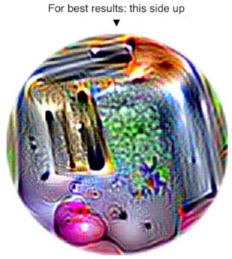
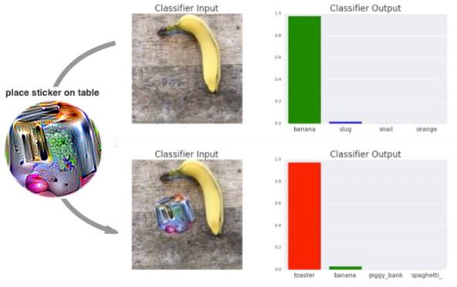
Adversarial Patch
https://arxiv.org/pdf/1712.09665.pdf

Slide 19
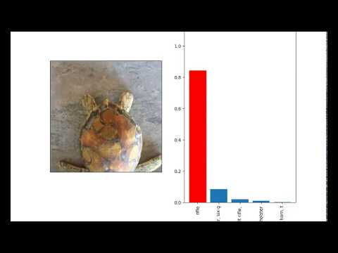
Synthesizing Robust Adversarial Examples
https://arxiv.org/pdf/1707.07397.pdf
Notes:
riffle == turtle:
https://habr.com/post/407991/
https://www.youtube.com/watch?v=YXy6oX1iNoA
https://www.theguardian.com/technology/2017/nov/03/googles-ai-turtle-rifle-mit-research-artificial-intelligence﻿

Slide 20
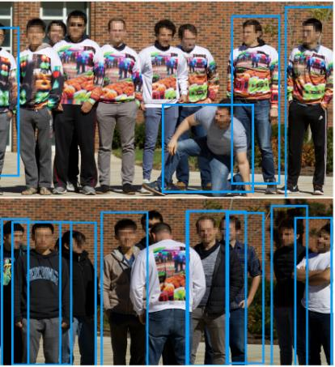
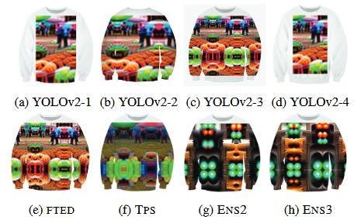
Making an Invisibility Cloak: Real World Adversarial Attacks on Object Detectors

Slide 21
Other Frontiers in CV
Better transfer learning and domain adaptation
CV in the medical field
Multimodality
Visual Question Answering
3D perception systems (of the autonomous car)
Disentangled representations
Self-Supervision
Model interpretability
Notes:
https://medium.com/sap-machine-learning-research/pushing-the-frontiers-of-computer-vision-insights-from-cvpr-2018-80dc9ceef4cb
// https://medium.com/airbnb-engineering/amenity-detection-and-beyond-new-frontiers-of-computer-vision-at-airbnb-144a4441b72e
https://nips.cc/Conferences/2019/CompetitionTrack
https://www.cv4gc.org/

Slide 22
Reference
Из физиков в Data Science https://habr.com/ru/company/ods/blog/345992/
DeepFakes:
https://habr.com/ru/company/pochtoy/blog/409855/
https://habr.com/ru/company/pochtoy/blog/467497/
Few-shot learning https://towardsdatascience.com/few-shot-learning-in-cvpr19-6c6892fc8c5

Slide 23
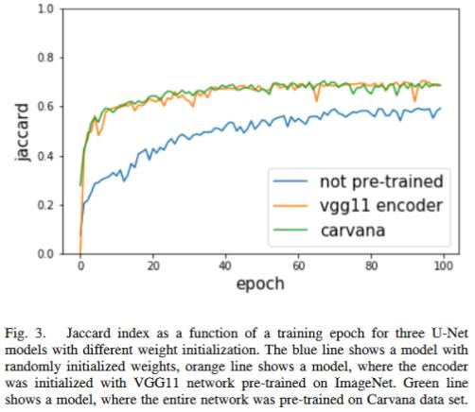
TernausNet
U-Net with VGG11 Encoder https://arxiv.org/pdf/1801.05746.pdf https://github.com/ternaus/TernausNet
Carvana Image Masking Challenge http://blog.kaggle.com/2017/12/22/carvana-image-masking-first-place-interview/
MICCAI 2017 Robotic Instrument Segmentation https://github.com/ternaus/robot-surgery-segmentation
Notes:
Jaccard Index is the same as Intersection over Union

Slide 24
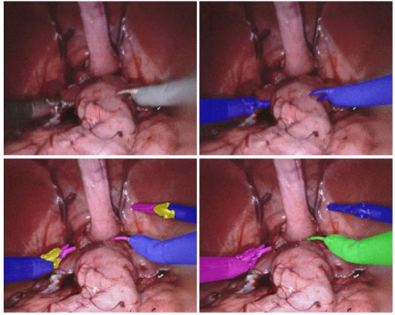
MICCAI 2017 Robotic Instrument Segmentation

Slide 25
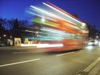
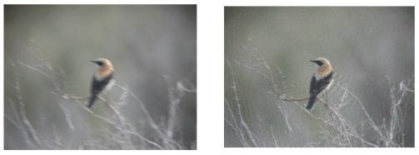
Motion deblurring
Orest Kupyn
https://arxiv.org/pdf/1711.07064.pdf

